Slide 1

Universal orlando resort
Max Unit
Conversant

Slide 2
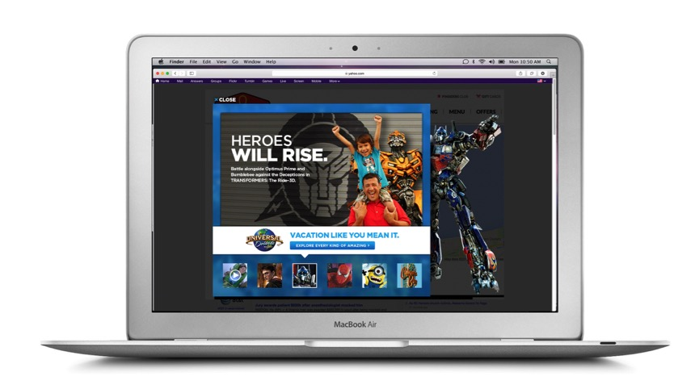
CREATIVE

Slide 3
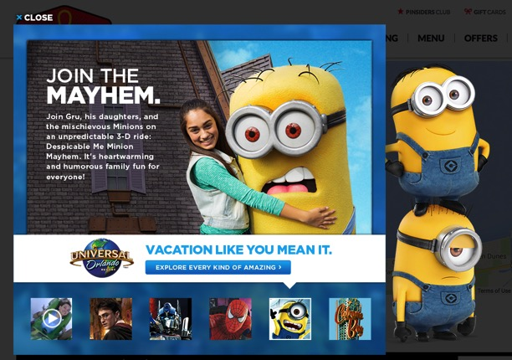
CREATIVE

Slide 4
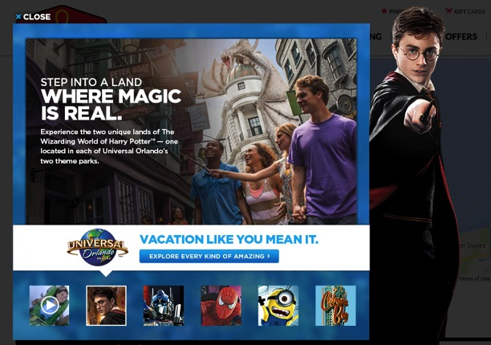
CREATIVE

Slide 5
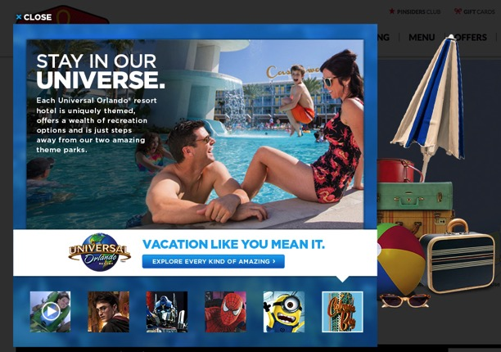
CREATIVE

Slide 6
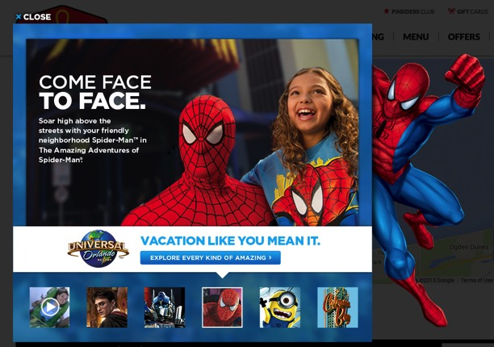
CREATIVE

Slide 7
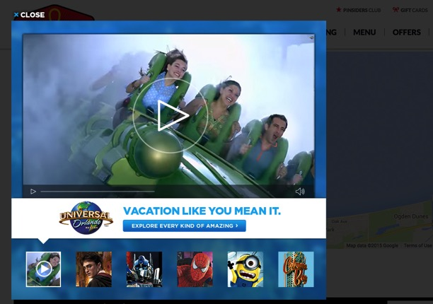
CREATIVE

